Slide 1
CRM Analytics and Sales Prediction System
Kakenova Zhanna

Slide 2
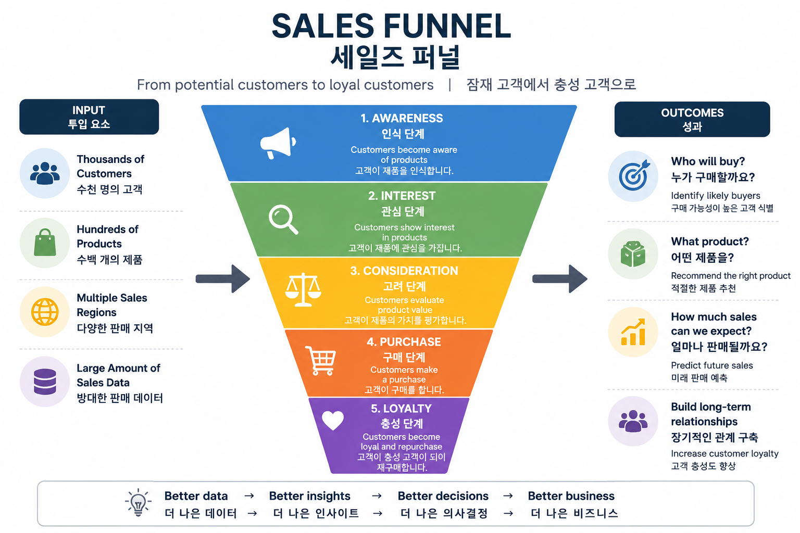
Business Problem & CRM Challenge

Slide 3
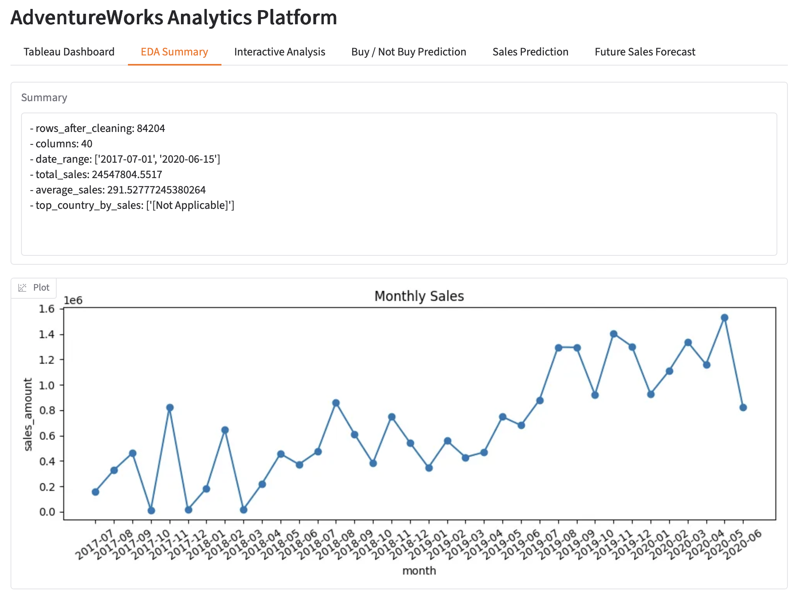
System Workflow
The workflow of the platform is:
AdventureWorks Data
→ Data Cleaning
→ Exploratory Data Analysis
→ CRM Analysis
→ Machine Learning Models
→ Prediction Services
→ Business Insights
The dataset was cleaned by removing missing values, duplicates, and invalid records before analysis.

Slide 4
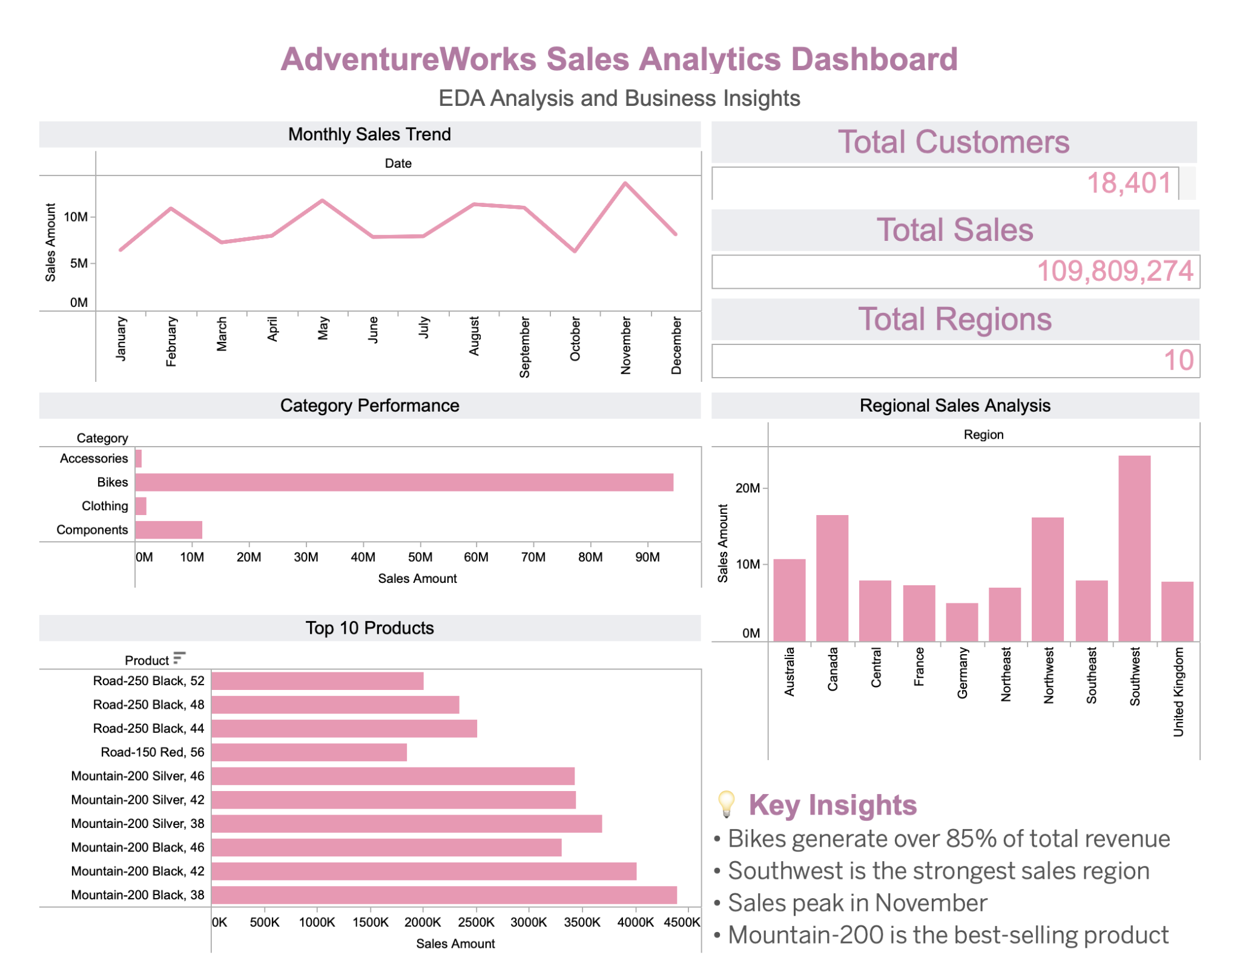
EDA Dashboard

Slide 5
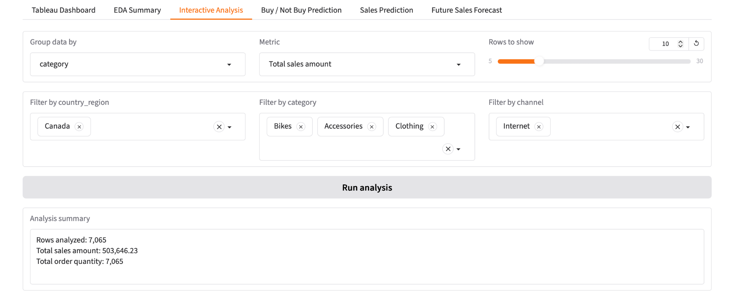
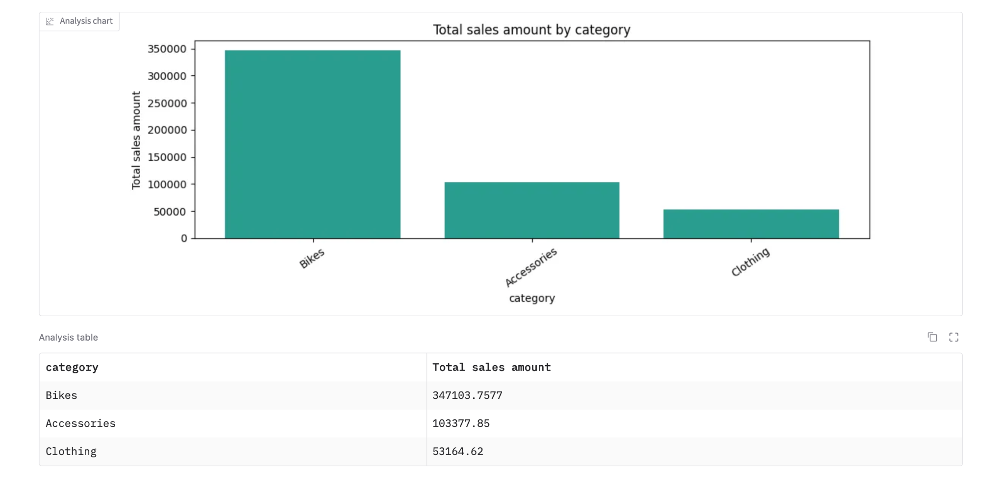
Interactive Analysis
The Interactive Analysis page allows users to explore the data dynamically.
Users can filter data by:
Country
Category
Sales Channel
Metrics
This enables managers to investigate customer behavior and sales performance from different business perspectives.
The platform supports data-driven decision making without writing any code.

Slide 6
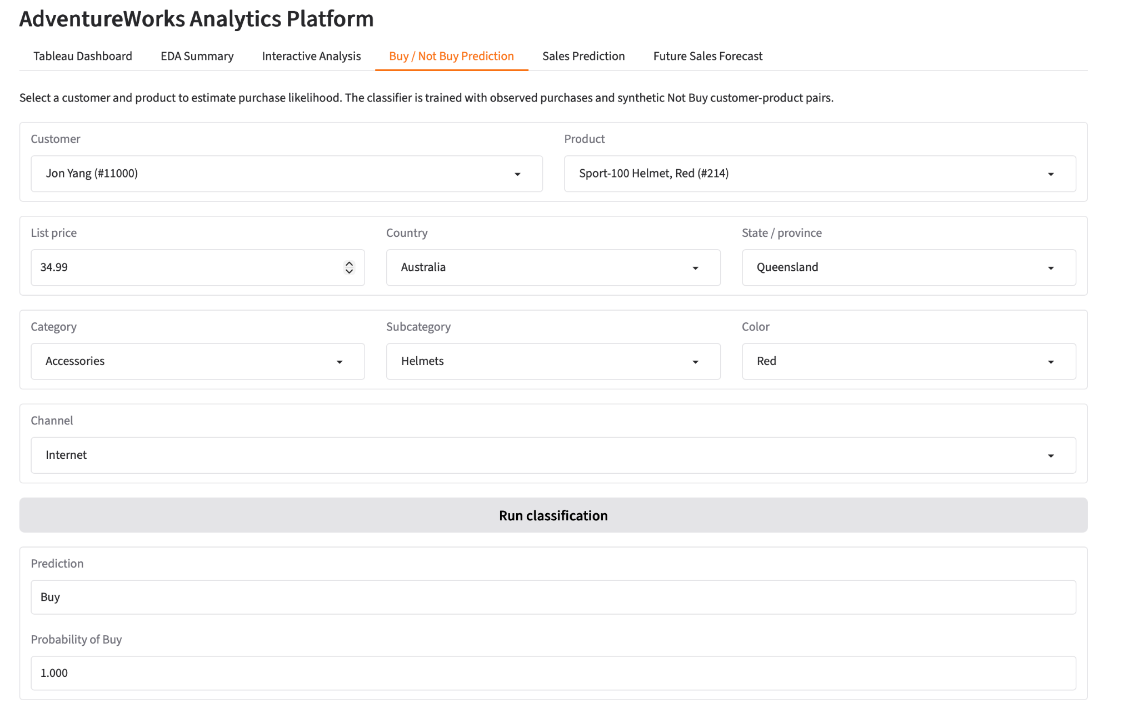
CRM Buy / Not Buy Prediction
The most important CRM feature is Buy / Not Buy Prediction.
The system receives:
Customer information
Product information
Location
Sales channel
Pricing information
Using a RandomForestClassifier with 200 trees, the model predicts whether the customer is likely to purchase the product.
Model Performance:
Accuracy = 89.6%
Precision = 89.6%
Recall = 89.6%
F1-score = 89.6%
This allows businesses to identify potential buyers and improve marketing efficiency.

Slide 7
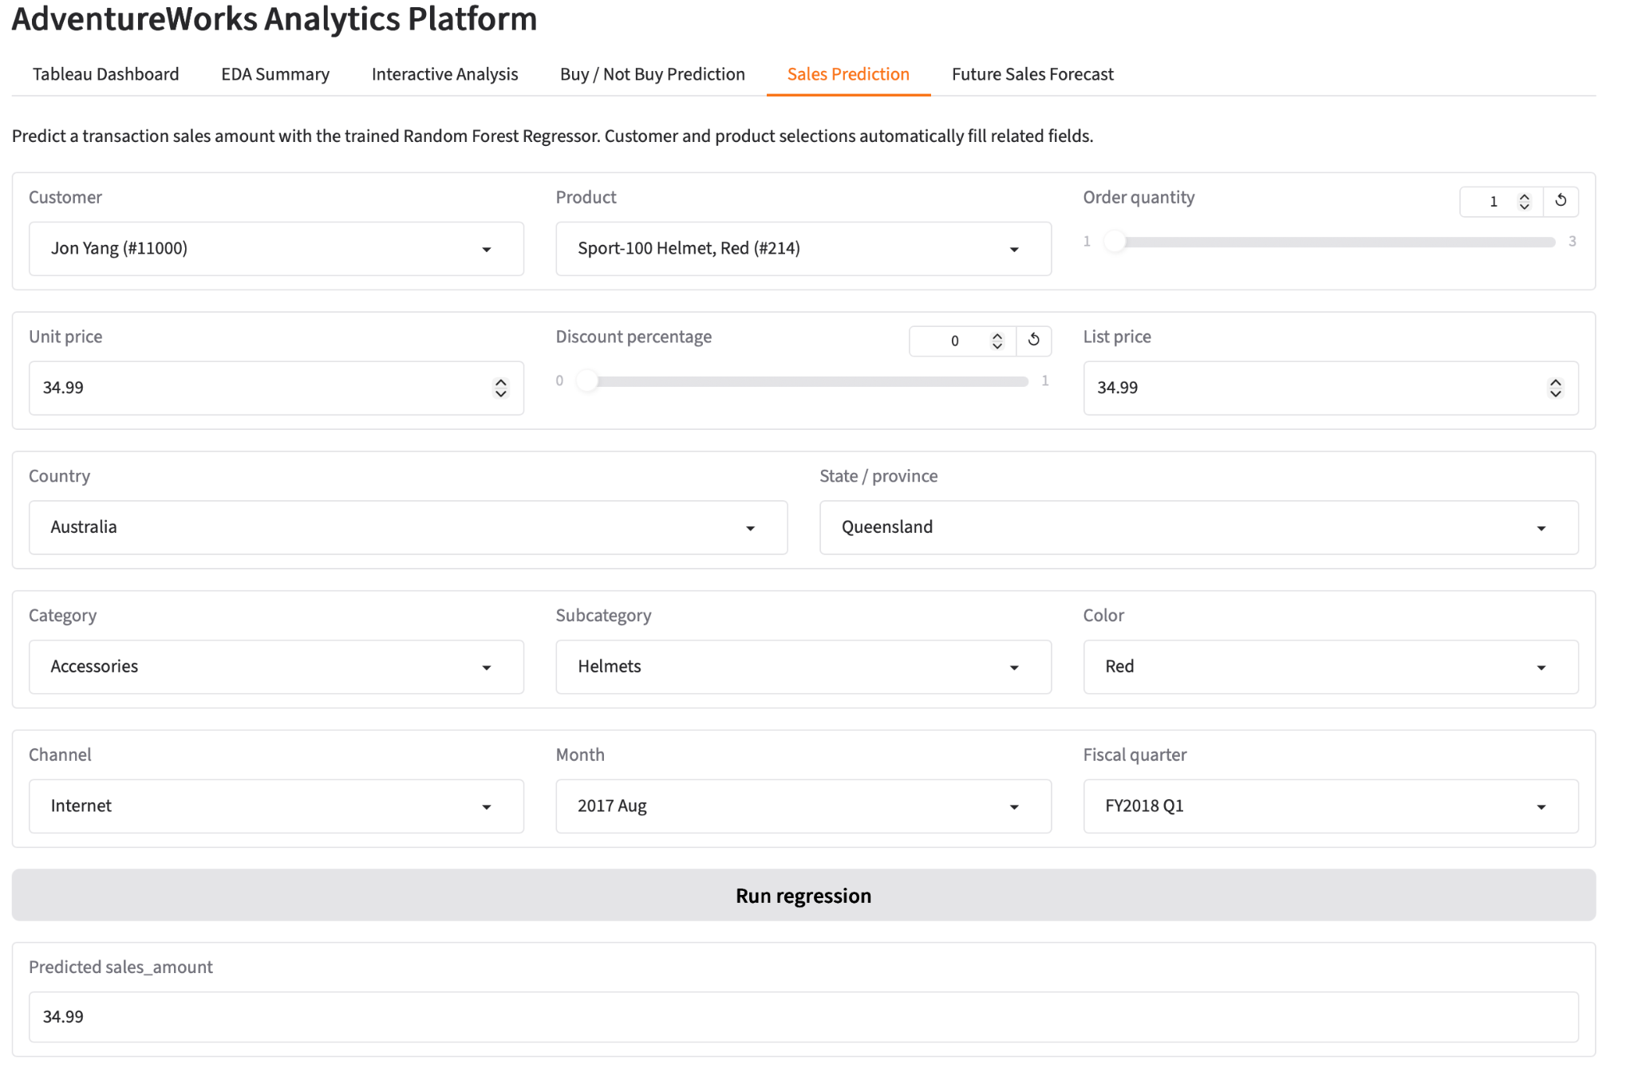
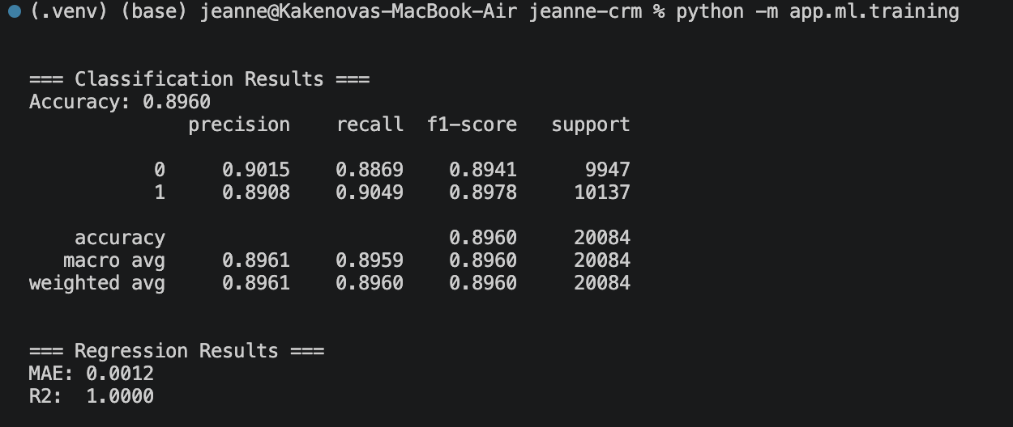
Sales Prediction
The second machine learning module predicts sales amount.
Input variables include:
Customer
Product
Quantity
Price
Discount
Region
Time information
The prediction model uses RandomForestRegressor with 300 trees.
The model achieved:
MAE = 0.0012
R² ≈ 1.00
This module helps estimate expected revenue before a transaction occurs.

Slide 8
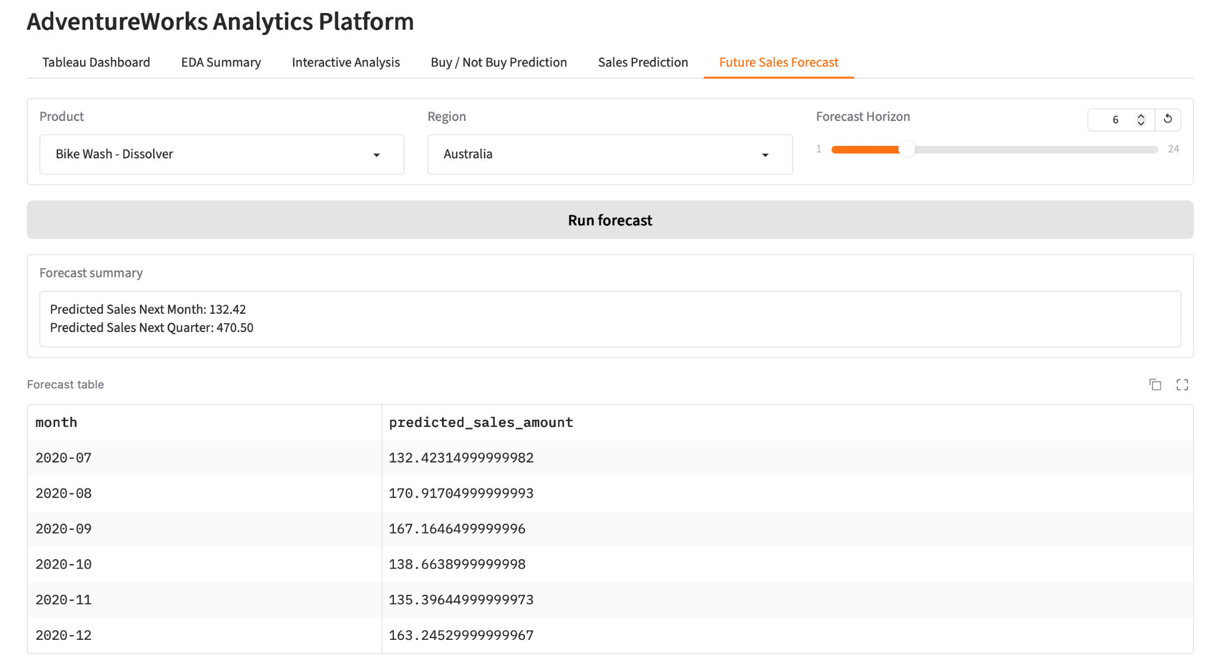
Future Sales Forecast
The platform also provides future sales forecasting.
Managers can select:
Product
Region
Forecast horizon
The system generates projected sales values and visualizes future trends.
This functionality supports inventory planning and strategic business decisions.

Slide 9




Technical Architecture
The platform was developed using:
• Pandas for data processing
• Scikit-Learn for machine learning
• FastAPI for REST API services
• Gradio for the user interface
• Docker for containerization
• Railway for cloud deployment
System Architecture:
AdventureWorks Dataset
→ Data Processing Layer
→ Machine Learning Layer
→ FastAPI Backend
→ Gradio Frontend
→ Railway Cloud Deployment
The application is fully deployable and accessible through a cloud environment, allowing users to interact with the CRM analytics platform through a web browser.

Slide 10
Conclusion
In conclusion, I developed a complete CRM Analytics Platform that integrates:
EDA Analysis
Customer Purchase Prediction
Sales Prediction
Future Sales Forecasting
The system transforms raw sales data into actionable business intelligence and supports data-driven CRM decision making.

Slide 11
Thank you for listening!

